Slide 1

Maryland Crime Data Analysis (1975 - 2020)
Author: Pascal Obeng-Poku- Data Analyst

Slide 2
EXECUTIVE SUMMARY
Objective: Identify Maryland crime patterns to assist in resource allocation.
Data Health: High-quality dataset with 1,104 records; minor missing values (approx. 2%) in percent change columns handled via mean-aggregation.

Slide 3
MOST COMMON CRIME TYPES (VOLUME)
Rank 1: Larceny Theft (~6.1 Million total incidents).
Rank 2: Burglary/B&E (~2.06 Million).
Rank 3: Motor Vehicle Theft (~1.1 Million).
Implication: Property crimes vastly outnumber violent crimes in Maryland, suggesting a need for broad-based community surveillance and theft prevention.

Slide 4
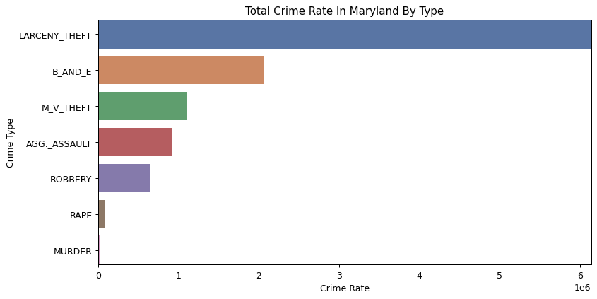

Slide 5
HOTSPOT IDENTIFICATION (2020 DATA)
By Volume:
Baltimore City (28,147)
Baltimore County (20,045)
Prince George's County (19,401)
By Rate (per 100k):
Baltimore City (4,782.1)
Dorchester County (3,093.7)
Worcester County (2,943.0)
Implication: Baltimore City remains the critical priority area, leading in both raw numbers and risk-per-resident.

Slide 6
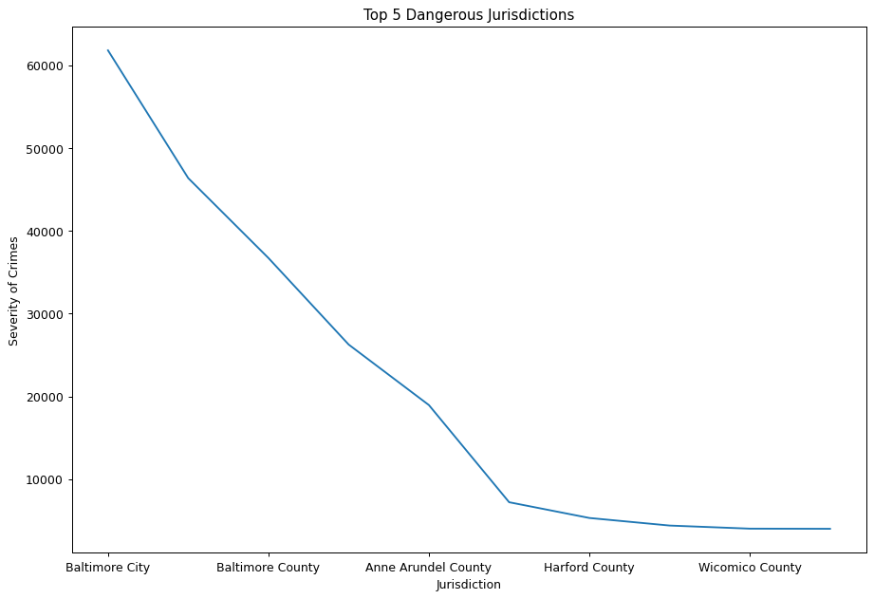

Slide 7
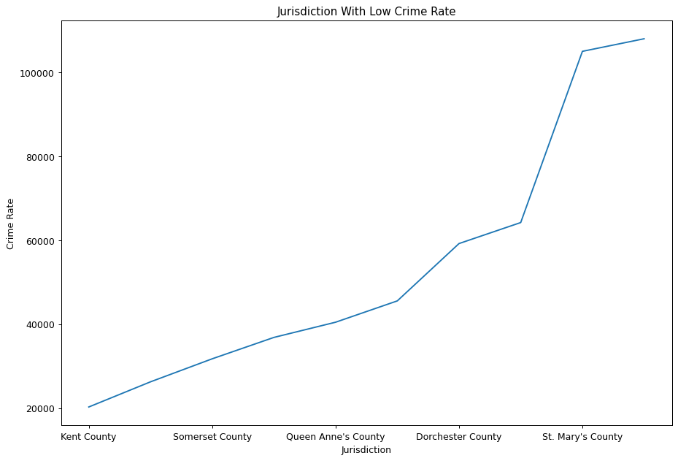

Slide 8
POPULATION VS. CRIME RATE
Total Volume: Strong positive correlation. As expected, more people = more crime.
Crime Rate: The smaller jurisdictions like Worcester and Dorchester have higher "danger levels" per person than many high-population suburban counties.
Implication: Policing resources should not just follow population; they must address high-rate rural and seasonal zones.

Slide 9
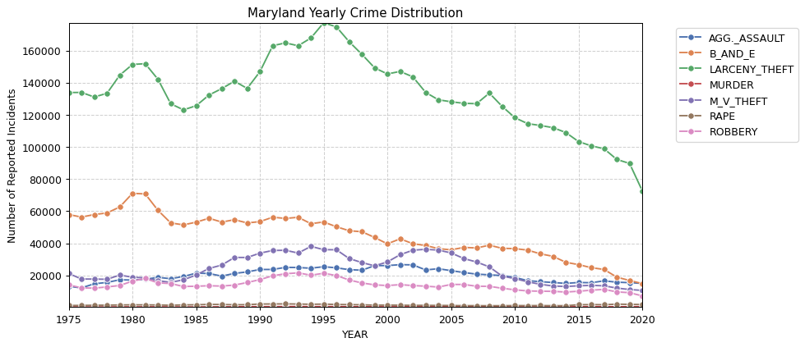

Slide 10
RECOMMENDATION
Strategic Resource Allocation (The "80/20" Rule)
Tier 1 Priority (Volume-Based): Since the "Big Five" (Baltimore City, Prince George's, Baltimore County, Montgomery, and Anne Arundel) account for over 75% of all incidents, the state should maintain a centralized Resource Hub. This hub would provide specialized forensics and investigative support that smaller counties cannot afford.
Tier 2 Priority (Rate-Based): High-rate rural areas like Dorchester and Allegany(Cumberland) require targeted Socio-Economic Intervention. High crime rates in these lower-population areas are often symptoms of the opioid crisis or unemployment; resources here should shift toward "Community-Oriented Policing" and addiction recovery services rather than just "boots on the ground."

Slide 11
RECOMMENDATION II
Specialized Crime Task Forces
Larceny & Property Crime Initiative: As Larceny Theft is the number 1 crime by a massive margin (over 6 million incidents), Maryland should implement a statewide Retail & Auto Theft Task Force. This includes promoting GPS-tracking for high-value items and improving lighting/surveillance in high-volume shopping districts in Montgomery and Anne Arundel counties.
Seasonal "Pop-Up" Policing: For Worcester County, the state should provide Temporary Duty (TDY) Officers during the summer months (May–September) to handle the tourism influx without overtaxing the small local permanent police force.

Slide 12
RECOMMENDATION III
Data-Driven Policy Improvements
Addressing Volatility: "Rate Percent Change" volatility in categories like Murder. Because a single incident in a small county can cause a 100% spike, the state should use a 3-Year Rolling Average for funding decisions rather than single-year data to avoid "knee-jerk" budget reactions.
Multicollinearity Monitoring: Since population and total crime are so highly correlated (r > 0.9), future models should focus on Residual Analysis—looking at jurisdictions that have more or less crime than their population would predict. Areas with "Negative Residuals" (less crime than expected) should be studied as "Success Models" for the rest of the state.

Slide 13
RECOMMENDATION IV
Public Safety Technology
Modernization of Reporting: Given the 1,104 entries across decades, Maryland should move toward Real-Time Dashboarding. Providing the public with the "Rate per 100k" (as you calculated) instead of just "Total Counts" will help residents have a more accurate understanding of their actual safety risk.

Slide 14
Thank you !!!

